Slide 1
Job-Bot Analyzer
Data Destroyers
Jing, Naga, Amitabha
09/30/2017

Slide 2
Job Analyzer
How to search for jobs?
Use Twitter
Where are the jobs?
Search for Jobs based on keywords by State & city from Data sources
Pull Company Reviews
Search by keywords Data Analyst ,Nursing ?
How do I find good Jobs?
-Jing
- Naga
Run Review & Entity Sentiment analysis
-Amitabha

Slide 3
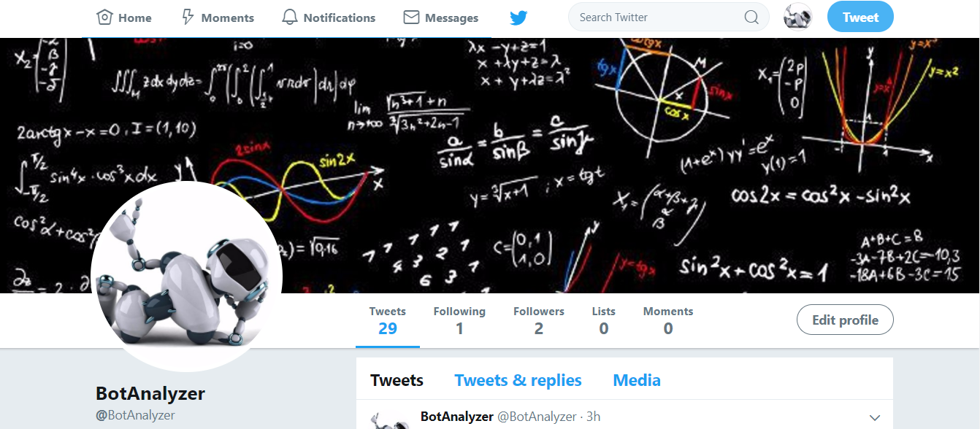
BotAnalyzer Twitter Account (Better Name? ) Jobbot? Job_bot? Botjob?.......

Slide 4
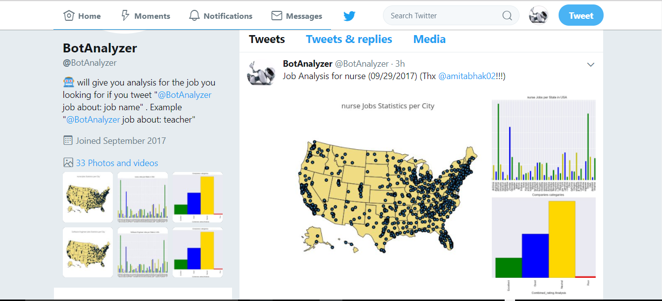

Slide 5
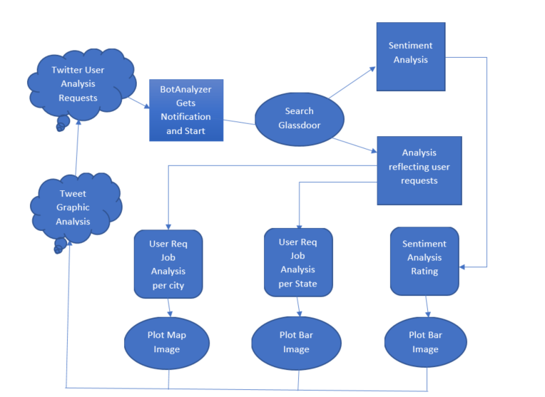
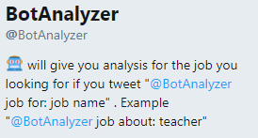
Workflow Diagram

Slide 6
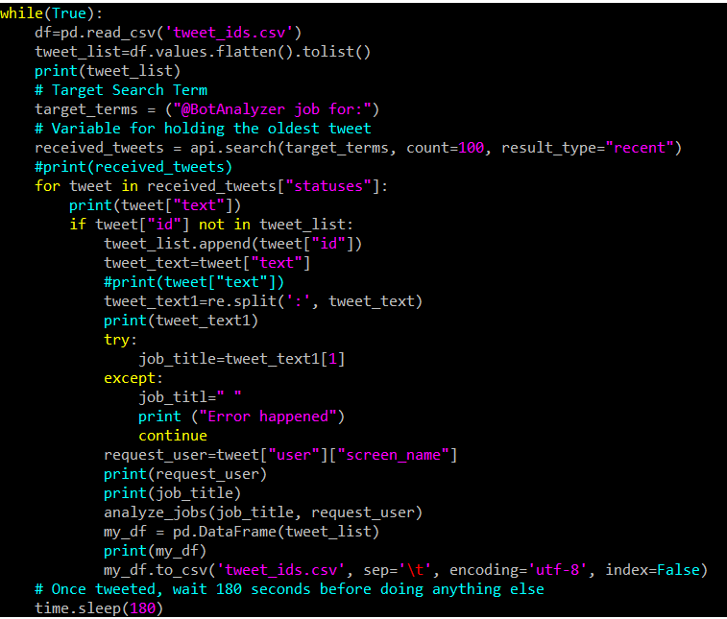

Slide 7
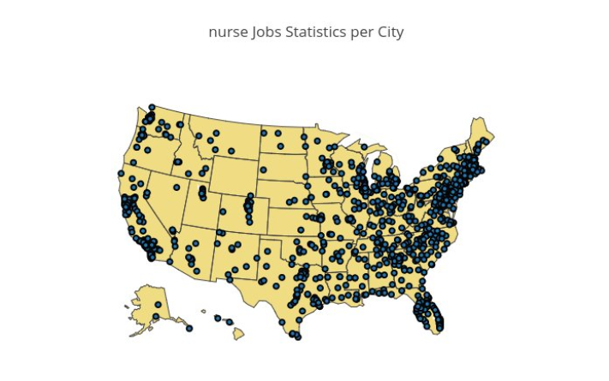

Slide 8
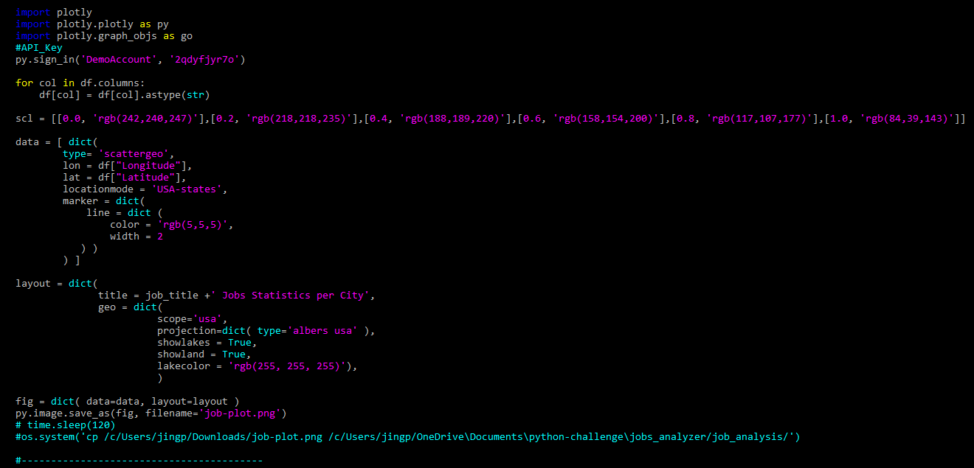
Thanks to Matt!!!

Slide 9
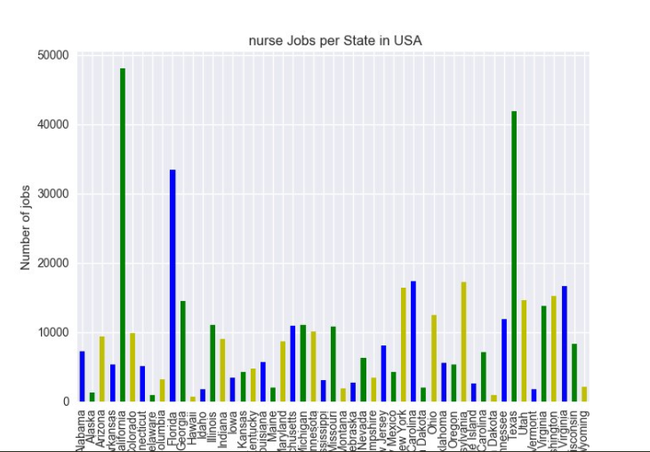
Where are the jobs?

Slide 10
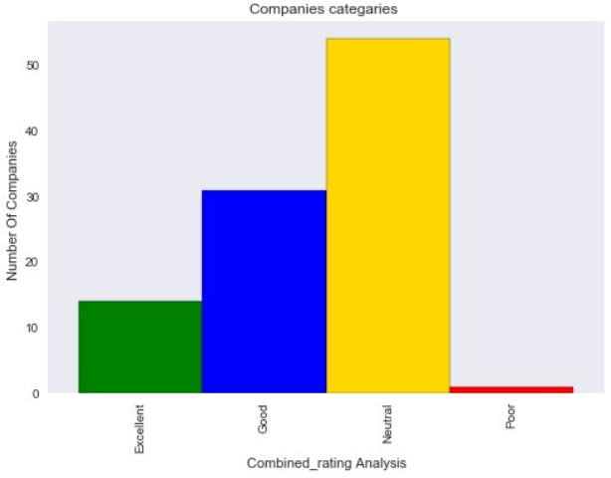

Slide 11
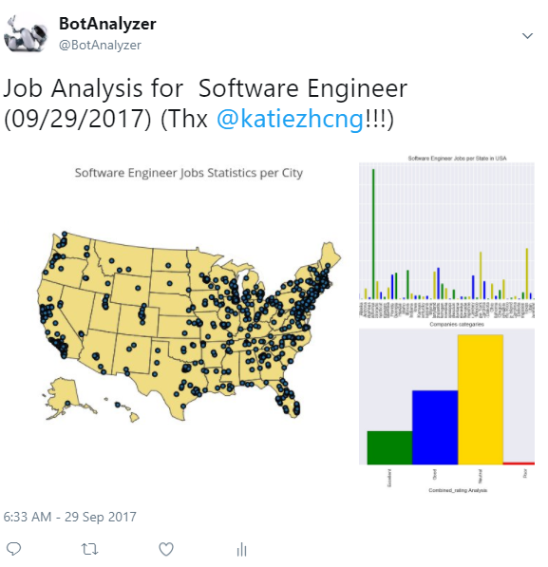
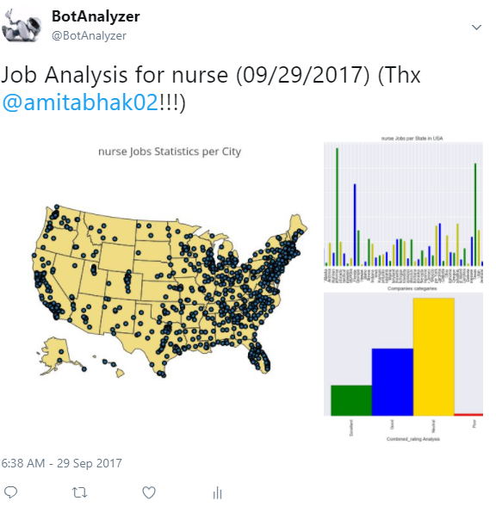

Slide 12
Identify Data Sources?
Glassdoor
Job Statistics
Job Postings =(Non Public)
Indeed
Job Search (Non-public)
Job Search (Non-Public)
Company Reviews
LinkedIn

Slide 13
Data Source: Job Statistics by City
Search By Job Title
Create API Request
Load and Save Output to DataFrame
Ex: Data Analyst
Job Title
City
Number of Jobs
Return by City
API Keys
Latitude
Longitude

Slide 14
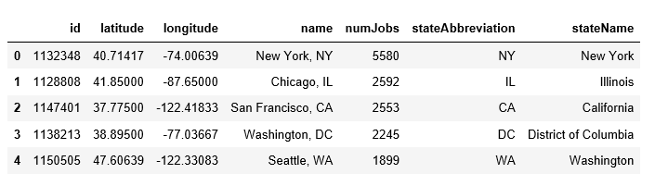
DataFrame: Job Statistics

Slide 15
Data Source: Company Review by Job Title
Search Employer By Job Title
Create API Request
Load and Save Output to DataFrame
Ex: Data Analyst
Job Title
Employer
Review
API Keys
Location

Slide 16
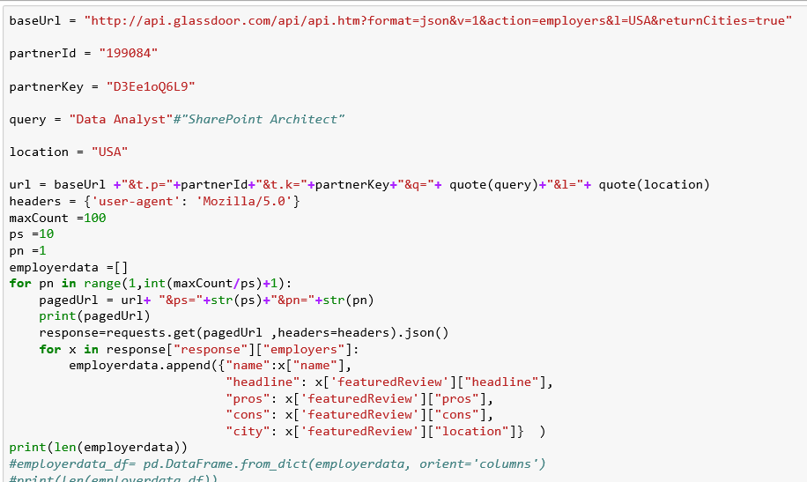
GlassDoor Api..

Slide 17
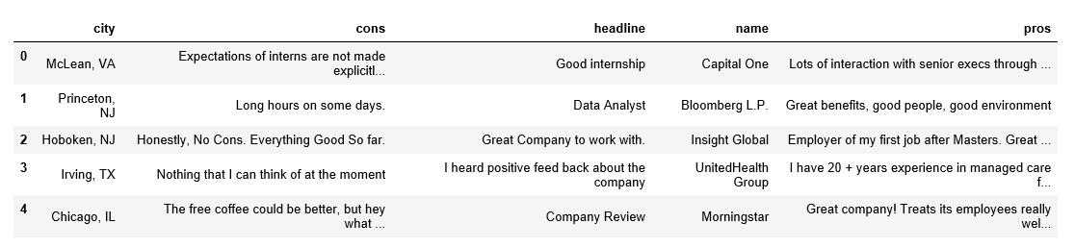
DataFrame: Company Reviews

Slide 18
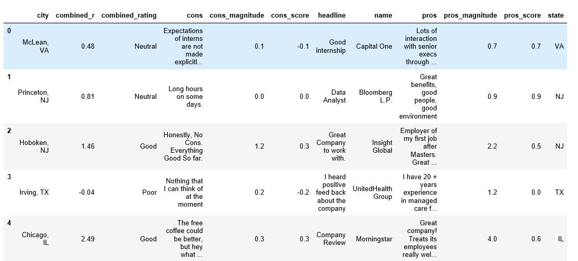
DataFrame: Company Review with Sentiment Analysis Score

Slide 19
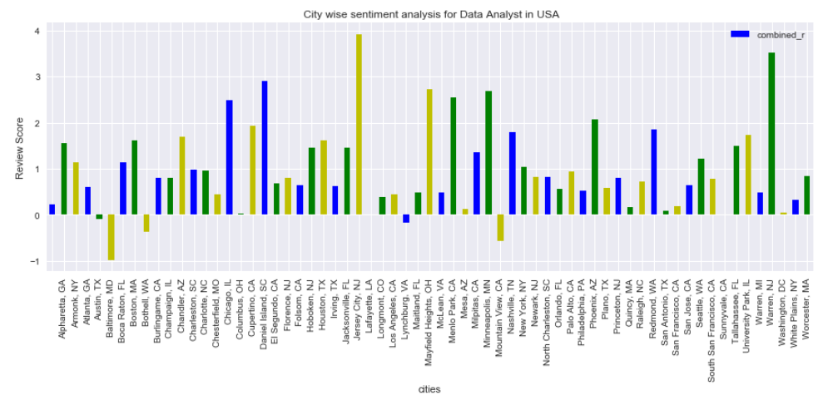
Employer Sentiment Score by city

Slide 20
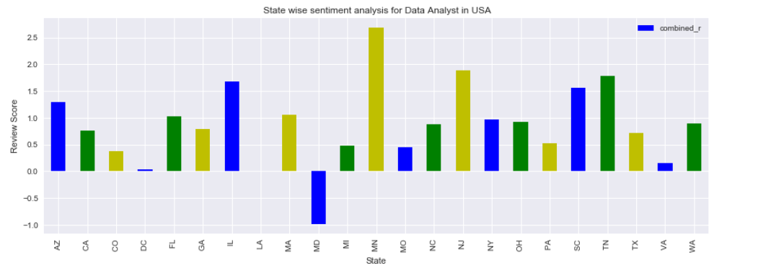
Employer Sentiment Score by State

Slide 21
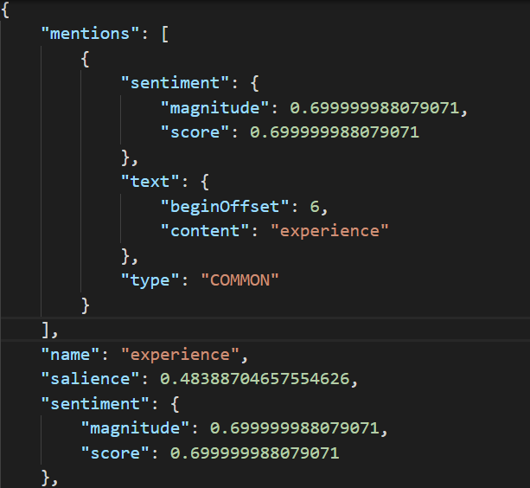
Employer Sentiment – Google NLP unleashed …
Great experience pros Did work in all 3 sectors People are great and friendly You work hard you get rewarded

Slide 22
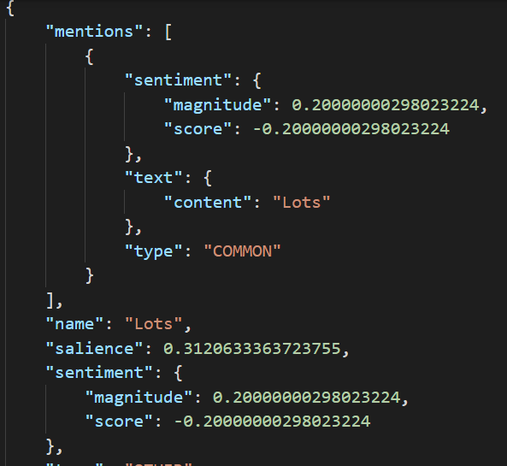
Employer Sentiment – Google NLP unleashed …
Lots of turnover due to contract model has a negative impact on continuity. Lack of clearly-defined directives to improve on, and advance, in the company.

Slide 23
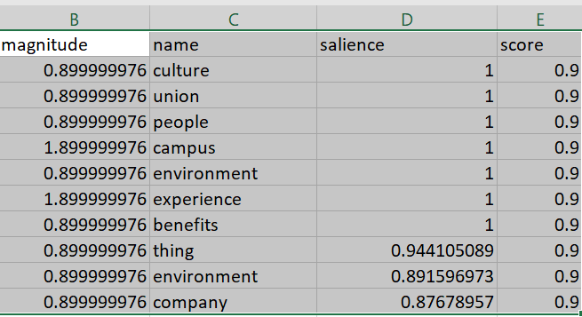
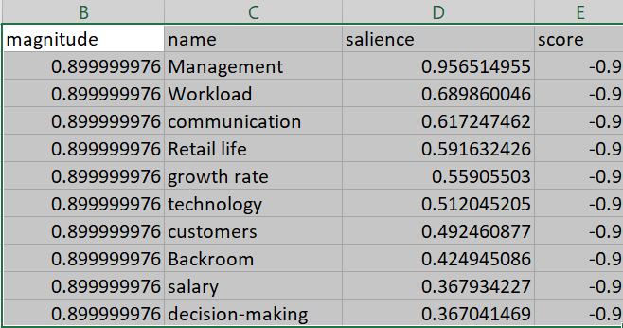
Employer Sentiment – Google NLP unleashed …
Top Positive Words
Top Negative Words

Slide 24
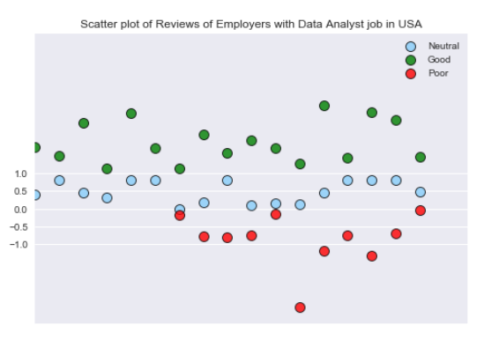
Distribution of words
Score
Words by Salience

Slide 25
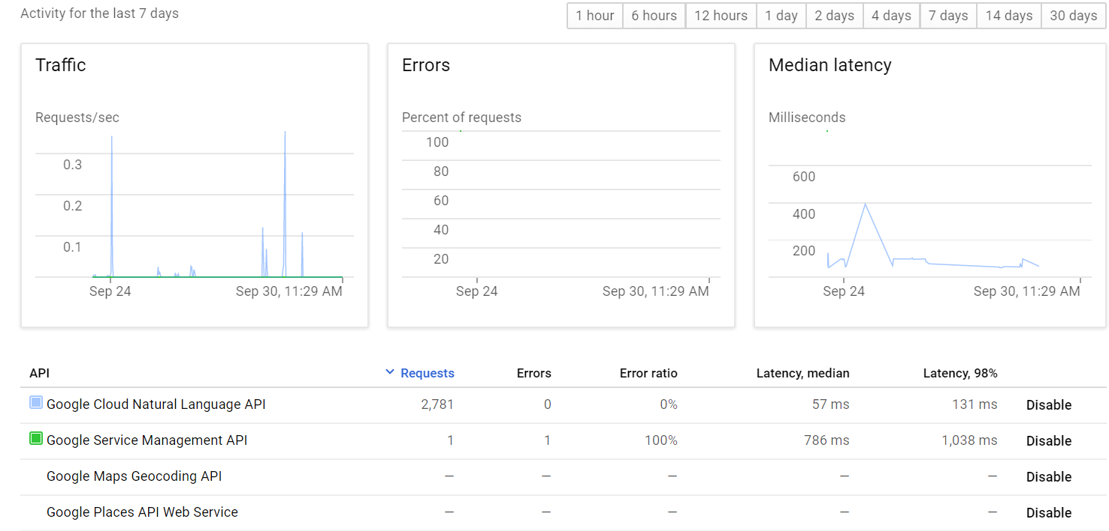
Employer Sentiment – Google Dashboard

